Slide 1
Data Mining: Classification
Tom Heskes

Slide 2
Classification: Definition
Given a collection of records (training set )‏
Each record contains a set of attributes, one of the attributes is the class.
Find a model for class attribute as a function of the values of other attributes.
Goal: previously unseen records should be assigned a class as accurately as possible.
A test set is used to determine the accuracy of the model. Usually, the given data set is divided into training and test sets, with training set used to build the model and test set used to validate it.

Slide 3

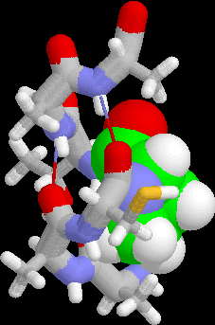
Examples of Classification Task
Predicting tumor cells as benign or malignant
Classifying credit card transactions as legitimate or fraudulent
Classifying secondary structures of protein as alpha-helix, beta-sheet, or random coil
Categorizing news stories as finance, weather, entertainment, sports, etc

Slide 4
Classification Techniques
Decision Tree based Methods
Rule-based Methods
Memory based reasoning
Neural Networks
Naïve Bayes and other Bayesian Networks
Support Vector Machines
….

Slide 5



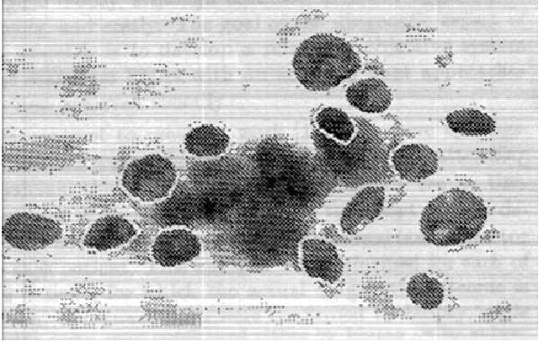


Classification tasks from the UCI ML repository
See http://archive.ics.uci.edu/ml/
Currently > 200 data sets for classification tasks
Hits
416585: Iris
293122: Adult
255322: Wine
211707: Breast Cancer Wisconsin (Diagnostic)
198442: Car Evaluation
163045: Abalone

Slide 6
Breast Cancer Wisconsin (Diagnostic)
Data Set Characteristics: Multivariate
Number of Instances: 569
Area: Life Sciences
Attribute Characteristics: Real
Number of Attributes: 32
Date Donated:1995-11-01
Associated Tasks: Classification
Missing Values? No
Source: Dr. William H. Wolberg, General Surgery Dept. University of Wisconsin, Clinical Sciences Center
Data Set Information: Features are computed from a digitized image of a fine needle aspirate (FNA) of a breast mass. They describe characteristics of the cell nuclei present in the image.

Slide 7
Breast Cancer Wisconsin (Diagnostic)
Attribute Information:
ID number Diagnosis (M = malignant, B = benign)
The other 30 attributes are real-valued and describe characteristics of the cell
nuclei present in the image

Slide 8
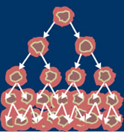
Breast Cancer Wisconsin (Diagnostic)
Decision tree model was obtained using a so-called Multisurface Method-Tree (MSM-T)
MSM-T uses linear programming to construct a decision tree
[K. P. Bennett, "Decision Tree Construction Via Linear Programming." Proceedings of the 4th Midwest Artificial Intelligence and Cognitive Science Society, pp. 97-101, 1992]

Slide 9
Classification Task

Slide 10
Example of a Decision Tree
categorical
categorical
continuous
class
Splitting Attributes
Refund
Yes
No
NO
MarSt
Single, Divorced
Married
TaxInc
NO
< 80K
>= 80K
NO
YES
Training Data
Model: Decision Tree

Slide 11
Another Example of a Decision Tree
categorical
categorical
continuous
class
MarSt
Single, Divorced
Married
NO
Refund
Yes
No
NO
TaxInc
< 80K
>= 80K
NO
YES
There can be more than one tree that fits the same data!

Slide 12
Decision Tree Classification Task
Decision Tree

Slide 13
Apply Model to Test Data
Start from the root of tree
Test Data
Refund
Yes
No
NO
MarSt
Single, Divorced
Married
TaxInc
NO
< 80K
>= 80K
NO
YES

Slide 14
Apply Model to Test Data
Test Data
Refund
Yes
No
NO
MarSt
Single, Divorced
Married
TaxInc
NO
< 80K
>= 80K
NO
YES

Slide 15
Apply Model to Test Data
Test Data
Refund
Yes
No
NO
MarSt
Single, Divorced
Married
TaxInc
NO
< 80K
>= 80K
NO
YES

Slide 16
Apply Model to Test Data
Refund
Yes
No
NO
MarSt
Single, Divorced
Married
TaxInc
NO
< 80K
>= 80K
NO
YES

Slide 17
Apply Model to Test Data
Test Data
Refund
Yes
No
NO
MarSt
Single, Divorced
Married
TaxInc
NO
< 80K
>= 80K
NO
YES

Slide 18
Apply Model to Test Data
Refund
Yes
No
NO
MarSt
Single, Divorced
Married
Assign Cheat to “No”
TaxInc
NO
< 80K
>= 80K
NO
YES

Slide 19
Decision Tree Classification Task
Decision Tree

Slide 20
Decision Tree Induction
Many Algorithms:
Hunt’s Algorithm (one of the earliest)‏
CART
ID3, C4.5
SLIQ,SPRINT

Slide 21
General Structure of Hunt’s Algorithm
Let D_{t} be the set of training records that reach a node t
General Procedure:
If D_{t} contains records that belong the same class y_{t}, then t is a leaf node labeled as y_{t}
If D_{t} is an empty set, then t is a leaf node labeled by the default class computed as the majority vote of the class labels of the records in the complete data set
If D_{t} contains records that belong to more than one class then a) select best attribute to split the data into smaller subsets, b) recursively apply the procedure to each of the resulting subsets
D_{t}
?

Slide 22
Hunt’s Algorithm
Refund
Don’t
Cheat
Yes
No
Don’t
Cheat
Don’t
Cheat
Refund
Refund
Yes
No
Yes
No
Don’t
Cheat
Marital
Status
Don’t
Cheat
Marital
Status
Single,
Divorced
Married
Single,
Divorced
Married
Cheat
Don’t
Cheat
Taxable
Income
Don’t
Cheat
< 80K
>= 80K
Don’t
Cheat
Cheat

Slide 23
Tree Induction
Greedy strategy.
Split the records based on an attribute test that optimizes certain criterion.
Issues
Determine how to split the records
How to specify the attribute test condition?
How to determine the best attribute to split on?
Determine when to stop splitting

Slide 24
Tree Induction
Greedy strategy.
Split the records based on an attribute test that optimizes certain criterion.
Issues
Determine how to split the records
How to specify the attribute test condition?
How to determine the best attribute to split on?
Determine when to stop splitting

Slide 25
Splitting an Attribute: How to Specify Test Condition?
Depends on attribute types
Nominal
Ordinal
Continuous
Depends on number of ways to split
2-way split
Multi-way split

Slide 26
Splitting Based on Nominal Attributes
Multi-way split: Use as many partitions as distinct values
Binary split: Divides values into two subsets; find coherent partitioning
CarType
Family
Luxury
Sports
CarType
CarType
{Sports, Luxury}
{Family}
OR
{Family, Luxury}
{Sports}

Slide 27
Splitting Based on Ordinal Attributes
Multi-way split: Use as many partitions as distinct values
Binary split: Divides values into two subsets; find optimal partitioning
What about this split?
Size
Small
Large
Medium
Size
OR
Size
{Small, Medium}
{Large}
{Medium, Large}
{Small}
Size
{Small, Large}
{Medium}

Slide 28
Splitting Based on Continuous Attributes
Different ways of handling:
Discretization to form an ordinal categorical attribute
Binary Decision: (A < v) or (A ≥ v)‏
Consider all possible splits and finds the best cut
Can be computationally intensive

Slide 29
Tree Induction
Greedy strategy
Split the records based on an attribute test that optimizes certain criterion.
Issues
Determine how to split the records
How to specify the attribute test condition?
How to determine the best attribute to split on?
Determine when to stop splitting

Slide 30
How to determine the Best Split
Before Splitting: 10 records of class 0, 10 records of class 1
Which test condition is the best?

Slide 31
How to determine the Best Split
Greedy approach:
Nodes with homogeneous class distribution are preferred
Need a measure of node impurity:
Non-homogeneous,
High degree of impurity
Homogeneous,
Low degree of impurity

Slide 32
Use Measures of Node Impurity
GINI index
Entropy
Misclassification error

Slide 33
Measure of Impurity: GINI Index
GINI index for a given node t : where p(c|t) is the relative frequency of class c at node t
Maximum (1 - 1/n_{c}) when records are equally distributed among all classes, implying highest impurity.
Minimum (0) when all records belong to one class, implying highest purity

Slide 34
Examples: Computing GINI of a Node
P(C1) = 0/6 = 0 P(C2) = 6/6 = 1
Gini = 1 – P(C1)² – P(C2)² = 1 – 0 – 1 = 0
P(C1) = 1/6 P(C2) = 5/6
Gini = 1 – (1/6)² – (5/6)² = 0.278
P(C1) = 2/6 P(C2) = 4/6
Gini = 1 – (2/6)² – (4/6)² = 0.444

Slide 35
Quality of a Split Based on GINI
Used in the decision tree algorithms CART, SLIQ, SPRINT.
When a node p is split into k partitions (children nodes), the quality of split is computed as
where n_{i} = number of records at child node i,
n = number of records at node p
35

Slide 36

Computing GINI Index for a Binary Attribute
B?
Yes
No
Node N1
Node N2
Gini(N1) = 1 – (5/7)² – (2/7)² = 0.41
Gini(N2) = 1 – (1/5)² – (4/5)² = 0.32
Gini(Children) = 7/12 × 0.41 + 5/12 × 0.32 = 0.37
36

Slide 37
GINI Index: Categorical Attributes
For each distinct value, gather counts for each class in the dataset
Use the count matrix to make decisions
Multi-way split
Two-way split
(find best partition of values)‏

Slide 38
GINI Index: Continuous Attributes
Use binary decisions based on one value
Simple (inefficient) method to choose best splitting value:
For each splitting value v, scan the database to gather the class count matrix and compute its Gini index
Select a v with the smallest Gini index
38

Slide 39
Binary Split Selection: Continuous Attributes
For each attribute a
Sort the values of a occurring in the records at that node
Scan these values, each time updating the count matrix and computing the GINI index of that split
Choose the split position that has the smallest GINI index
Sorted Values
Split Positions

Slide 40
Measure of Impurity: Entropy
Entropy at a given node t: where p(c|t) is the relative frequency of class c at node t
Measures homogeneity of a node
Maximum (log n_{c}) when records are equally distributed among all classes implying highest impurity
Minimum (0) when all records belong to one class, implying highest purity

Slide 41
Examples for Computing Entropy of a Node
P(C1) = 0/6 = 0 P(C2) = 6/6 = 1
Entropy = – 0 log 0 – 1 log 1 = – 0 – 0 = 0
P(C1) = 1/6 P(C2) = 5/6
Entropy = – (1/6) log₂ (1/6) – (5/6) log₂ (5/6) = 0.65
P(C1) = 2/6 P(C2) = 4/6
Entropy = – (2/6) log₂ (2/6) – (4/6) log₂ (4/6) = 0.92

Slide 42
Quality of a Split Using Entropy: Information Gain
Information Gain:
Parent node p is split into k partitions;
n_{i} is number of records in partition i
Measures reduction in entropy achieved when using split to partition the values of attribute a
Choose the split with maximum GAIN
Used in ID3 and C4.5
Disadvantage: tends to prefer splits that result in large number of partitions, each being small but pure
42

Slide 43
GainRATIO: Adjusted Information Gain
Parent node p is split into k partitions
n_{i} is the number of records in partition i
Adjusts Information Gain by the entropy of the partitioning (SplitINFO)
Higher entropy partitioning (large number of small partitions) is penalized!
Used in C4.5
Designed to overcome the disadvantage of Information Gain
43
43

Slide 44
Measure of Impurity: Classification Error
Classification error at a node t:
Measures misclassification error made by a node
Maximum (1 - 1/n_{c}) when records are equally distributed among all classes, implying highest impurity
Minimum (0) when all records belong to one class, implying highest purity

Slide 45
Examples for Computing Error
P(C1) = 0/6 = 0 P(C2) = 6/6 = 1
Error = 1 – max (0, 1) = 1 – 1 = 0
P(C1) = 1/6 P(C2) = 5/6
Error = 1 – max (1/6, 5/6) = 1 – 5/6 = 1/6
P(C1) = 2/6 P(C2) = 4/6
Error = 1 – max (2/6, 4/6) = 1 – 4/6 = 1/3

Slide 46
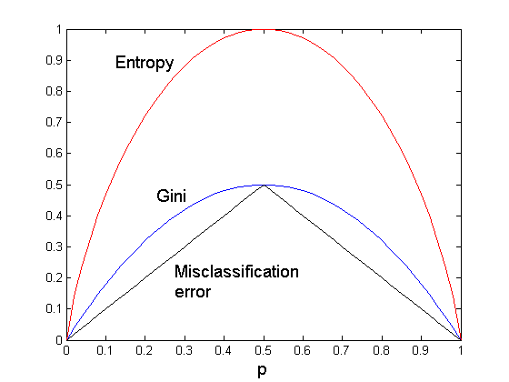
Comparison among Splitting Criteria
For a 2-class problem:

Slide 47
Misclassification Error vs Gini
A?
Yes
No
Node N1
Node N2
Gini(N1) = 1 – (3/3)² – (0/3)² = 0
Gini(N2) = 1 – (4/7)² – (3/7)² = 0.4898
Gini(Children) = 3/10 × 0 + 7/10 × 0.4898 = 0.3429

Slide 48
Stopping Criteria for Tree Induction
Stop expanding a node when all the records belong to the same class
Stop expanding a node when all the records have similar attribute values
Early termination (to be discussed later)‏

Slide 49
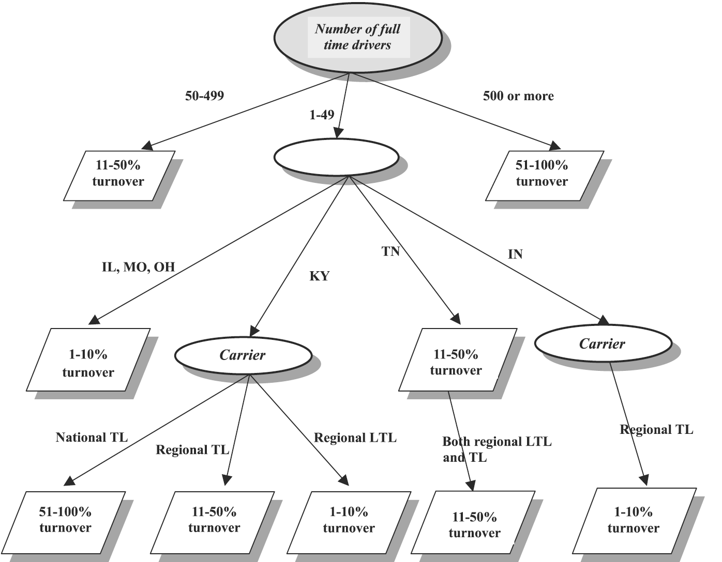
Example: Truck Driver Turnover

Slide 50
Decision Tree Based Classification: Advantages
Inexpensive to construct
Extremely fast at classifying unknown records
Easy to interpret for small-sized trees
Accuracy is comparable to other classification techniques for many simple data sets

Slide 51
Example: C4.5
Simple depth-first construction
Uses Information Gain
Sorts continuous attributes at each node
Needs entire data to fit in memory
Unsuitable for large datasets
Needs out-of-core sorting
Software freely available from: http://www.cse.unsw.edu.au/~quinlan/c4.5r8.tar.gz

Slide 52
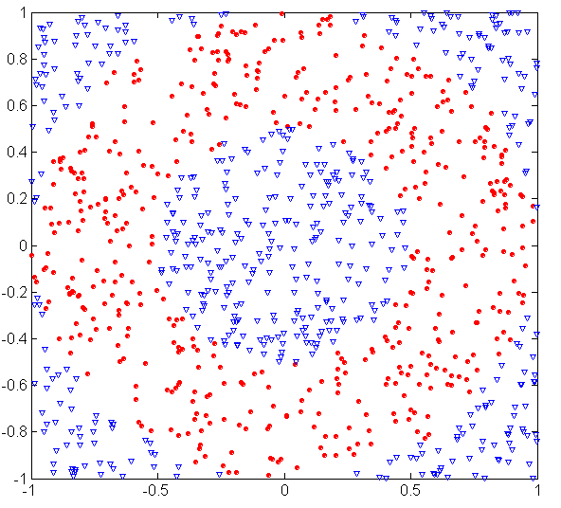
Underfitting and Overfitting (Example)‏
500 circular and 500 triangular data points.
Circular points:
0.5 ≤ sqrt(x₁²+x₂²) ≤ 1
Triangular points:
sqrt(x₁²+x₂²) < 0.5 or
sqrt(x₁²+x₂²) > 1

Slide 53
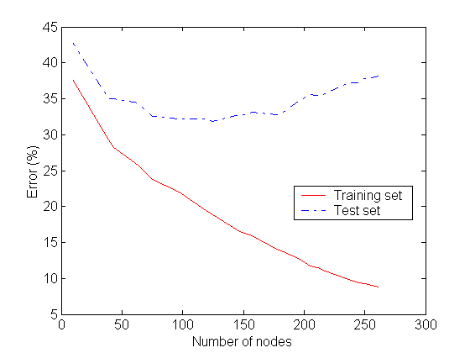
Underfitting and Overfitting
Overfitting
Underfitting: when model is too simple, both training and test errors are large

Slide 54
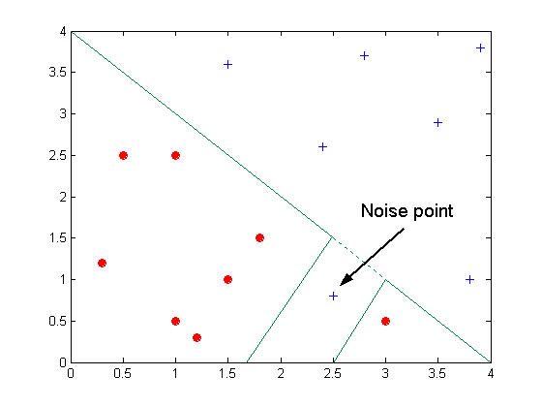
Overfitting Due to Noise
Decision boundary is distorted by noise point

Slide 55
Notes on Overfitting
Overfitting results in decision trees that are more complex than necessary
Training error no longer provides a good estimate of how well the tree will perform on previously unseen records
Need new ways for estimating errors

Slide 56
Estimating Generalization Error
Training / re-substitution error: error on training data
Generalization error: error on independent test data
Methods for estimating generalization error
Optimistic approach: generalization error = training error
Pessimistic approach:
For each leaf node, add 0.5 to training error: generalization error = training error + N × 0.5 with N the number of leaf nodes
For a tree with 30 leaf nodes and 10 errors out of 1000 training instances: training error = 10/1000 = 0.01; generalization error = (10+30×0.5)/1000 = 0.025
Reduced error pruning (REP):
uses validation data set to estimate generalization error

Slide 57
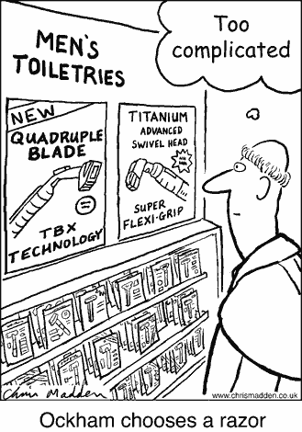
Occam’s Razor
Given two models of similar generalization errors, one should prefer the simpler model over the more complex model
For complex models, there is a greater chance that it was fitted accidentally by errors in data
Therefore, one should include model complexity when evaluating a model

Slide 58
Minimum Description Length (MDL)‏
Cost(Model,Data) = Cost(Data|Model) + Cost(Model)‏
Cost is the number of bits needed for encoding
Search for the least costly model
Cost(Data|Model) encodes the misclassification errors.
Cost(Model) uses node encoding (number of children) plus splitting condition encoding

Slide 59
How to Address Overfitting: Pre Pruning
Pre pruning (early stopping rules)‏
Stop the algorithm before it becomes a fully-grown tree
Typical stopping conditions for a node:
Stop if all instances belong to the same class
Stop if all the attribute values are the same
More restrictive conditions:
Stop if number of instances is less than some user-specified threshold
Stop if class distribution of instances are independent of the available features (e.g., using a χ² test)‏
Stop if expanding the current node does not improve impurity measures (e.g., Gini or information gain)

Slide 60
How to Address Overfitting: Post Pruning
Post pruning
Grow decision tree to its entirety and then try to prune
Trim the nodes of the decision tree in a bottom-up fashion
If generalization error improves after trimming, replace sub-tree by a leaf node
Class label of leaf node is determined from majority class of instances in the sub-tree that was removed
Can use MDL for post-pruning

Slide 61
Example of Post-Pruning
Training Error (Before splitting) = 10/30
Pessimistic error = (10 + 0.5)/30 = 10.5/30
Training Error (After splitting) = 9/30
Pessimistic error (After splitting)‏
= (9 + 4 ×0.5)/30 = 11/30
Prune!
Class = Yes
20
Class = No
10
Error = 10/30
Class = Yes
8
Class = Yes
3
Class = Yes
4
Class = Yes
5
Class = No
4
Class = No
4
Class = No
1
Class = No
1

Slide 62
Search Strategy
Finding an optimal decision tree is NP-hard
The algorithm presented so far uses a greedy, top-down, recursive partitioning strategy to induce a reasonable solution
Other strategies?
Bottom-up
Bi-directional

Slide 63
Expressiveness
Decision trees provide an expressive representation for learning discrete-valued function
But they do not generalize well to all types of Boolean functions
E.g., parity function:
Class = 1 if there is an even number of Boolean attributes with truth value = True
Class = 0 if there is an odd number of Boolean attributes with truth value = True
Decision tree has depth equal to number of attributes…
Not always expressive enough for modeling continuous variables
Particularly when test condition involves only a single attribute at a time

Slide 64
Decision Boundary
Decision boundary is parallel to axes because test condition involves a single attribute at a time

Slide 65
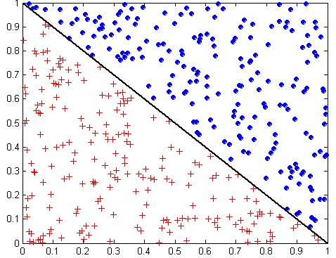
Oblique Decision Trees
x + y < 1
Class = +
Class =
Test condition may involve multiple attributes
More expressive representation
Finding optimal test condition is computationally expensive

